Slide 1
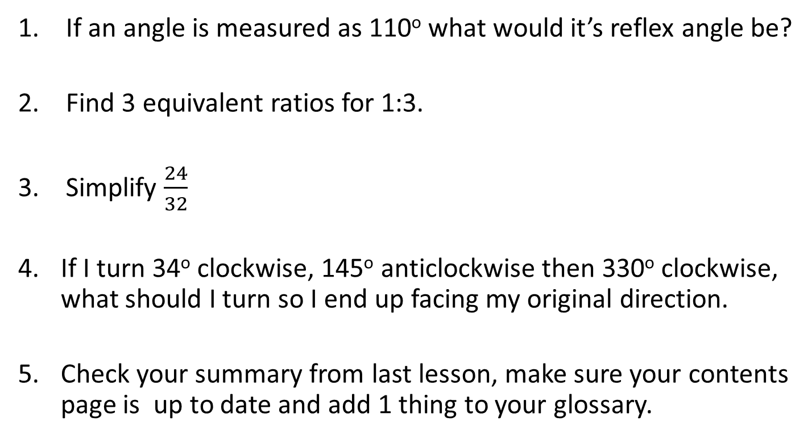
5 questions
If an angle is measured as 110º what would it’s reflex angle be?
Find 3 equivalent ratios for 1:3.
Simplify $\frac{24}{32}$
If I turn 34º clockwise, 145º anticlockwise then 330º clockwise, what should I turn so I end up facing my original direction.
Check your summary from last lesson, make sure your contents page is up to date and add 1 thing to your glossary.

Slide 2
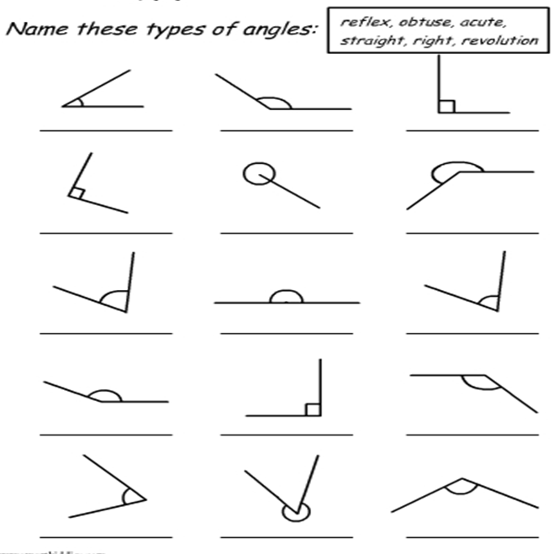
Name these angles
Notes:
revision

Slide 3
Name these angles
Acute
Right
Acute
Obtuse
Acute
Obtuse
Revolution
Straight
Right
Reflex
Right
Reflex
Acute
Obtuse
Obtuse
Notes:
solution

Slide 4
24
7
30
Date
Angles
EQ – How can we describe different angle relationships?
5
Notes:
Lesson objective (EQ)

Slide 5
Lesson objective
By the end of this lesson you will be able to;
Identify the different types of angles (complementary, supplementary etc.)
Use the angle relationships to determine unknown angles
Notes:
Lesson objective

Slide 6
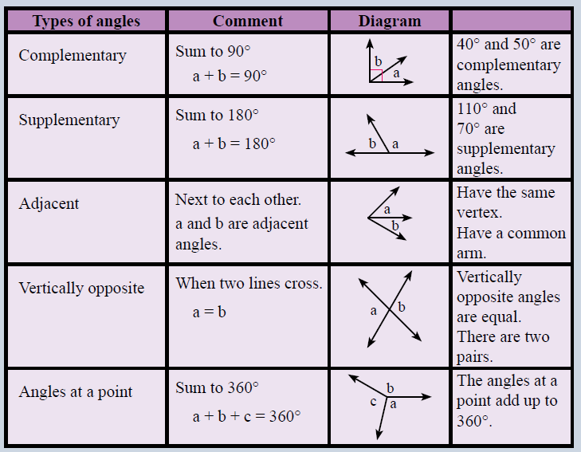
Complete the table and glue into your notes
Notes:
Hand out table to students to fill in

Slide 7
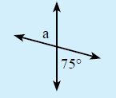

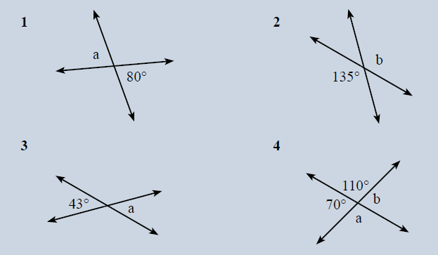
Vertically opposite Angles
Notes:
Work through example then students complete questions

Slide 8
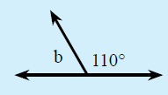

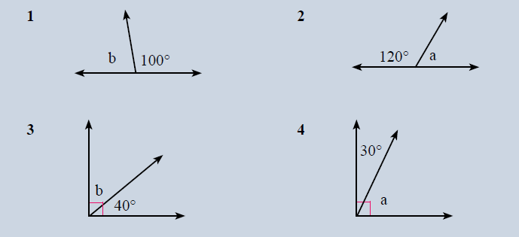
Complementary and Supplementary
Notes:
Work through example then students complete questions

Slide 9

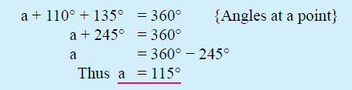
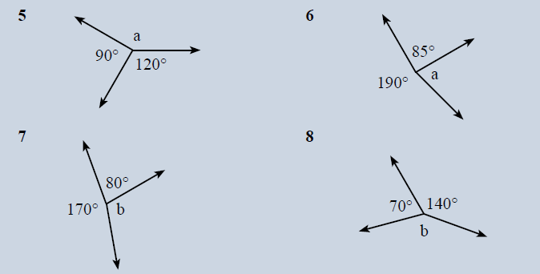
Angles at a point
Notes:
Work through example then students complete questions

Slide 10
Silent card Shuffle
Close your books!
Cut the cards out
Sort the cards into their correct groups
You have 2 minutes
Notes:
WICOR: Reading and Collaboration

Slide 11
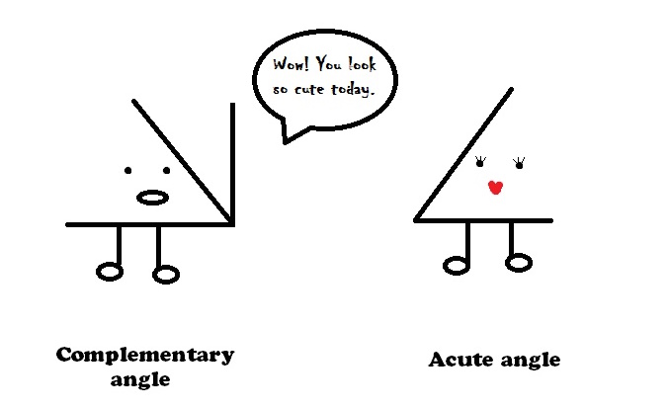
Acute math pun
Notes:
Closure

